Slide 1
Solution to an equation
Solving linear equations

Slide 2
how to use Oak lessons

Slide 3
I can appreciate that a solution is a value that makes the two sides of an equation balance.

Slide 4
A solution to an equality with one variable is a value for the variable which, when substituted, maintains the equality between the expressions.
The process of finding a solution to an equation is called solving.

Slide 5

Solution to an equation
Testing solutions to equations
Finding solutions from graphs

Slide 6
Testing solutions to equations
In an expression, the variable can take any value.
This is sometimes restricted by context e.g. where values have to be positive or integers.
We can use substitution to find the value of the expression for different values of the variable.
What is the value of of the expression 3p − 7 when p = 5 ?
3(5) − 7 We can substitute 5 as the value of p
15 − 7 Then calculate
8 So, when p = 5 , 3p − 7 = 8

Slide 7
Testing solutions to equations
We can find different values of the expression by substituting different values for the variable.
p | 3p − 7
−3
−2
−1
0
1
2
3
4
5
We have seen that, 3p − 7 = 8 when p = 5
−16
What is the value of 3p − 7 when p = −3 ?
−13
3(−3) − 7
−9 − 7
−16
3(−2) − 7
−6 − 7
−13
3(−1) − 7
−3 − 7
−10
−10
−7
−4
−1
When does 3p − 7 have a value of 2?
when p = 3
2
5
(3p − 7 is a linear expression so as the value of p increases by 1, the expression increases at a constant rate.)
8

Slide 8
Testing solutions to equations
If we now form an equation, 3p − 7 = 5, we can find the specific value of the unknown that makes this equation true.
p | 3p − 7
−3
−2
−1
0
1
2
3
4
5
Looking at our table, 3p − 7 has a value of 5 when p = 4
−16
−13
The solution to the equation 3p − 7 = 5 is when p has a value of 4
−10
−7
−4
A solution to an equation with one variable is a value for the variable that makes both sides of the equation balance.
−1
2
5
8
The process of finding a solution is called solving.

Slide 9
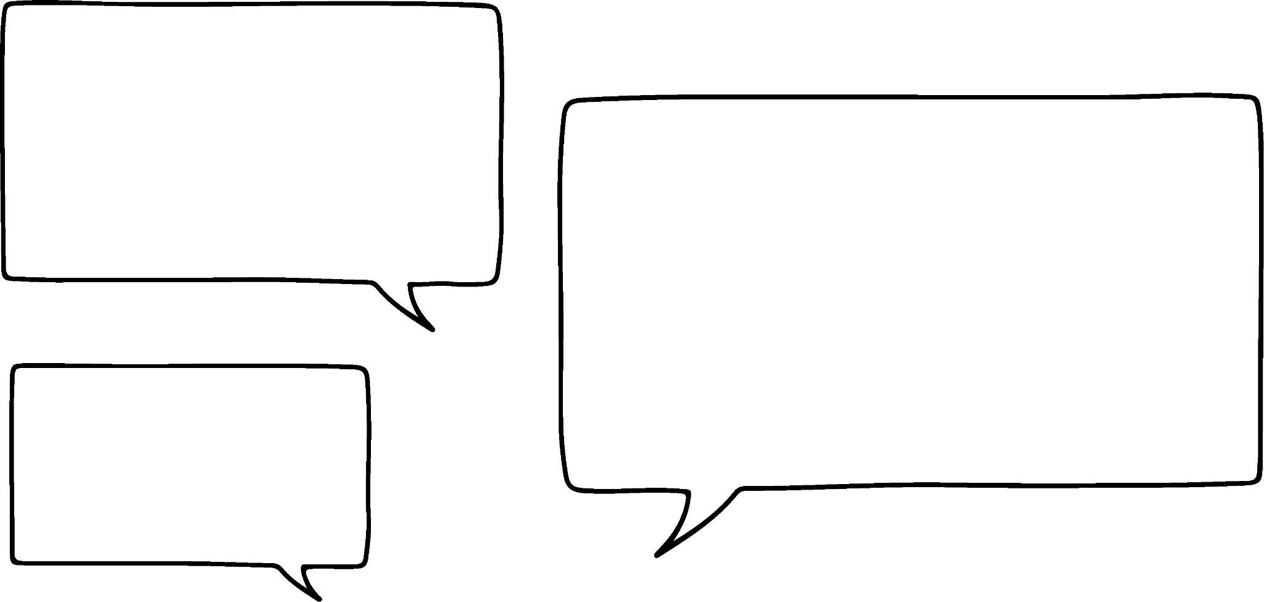

Testing solutions to equations
p | 3p − 7
−3
−2
−1
0
1
2
3
4
5
What is the solution to the equation 3p − 7 = −1 ?
−16
When p = 2
−13
−10
What is the solution to the equation 3p − 7 = −10 ?
−7
When p = −1
−4
−1
The solution to 3p − 7 = 17 is when p has a value of 8
2
5
8
Jun
How could we check if Jun is correct?
3(8) − 7 = 17
24 − 7 = 17
17 = 17
Both sides of the equation are equal when p = 8 So Jun is correct.

Slide 10
Testing solutions to equations
Substituting different values for the variables is not an efficient method to find a solution.
It can be time consuming when the solution is very big or very small.
It can be difficult to find when not an integer.
However it is a useful method for checking a solution once you have found one.

Slide 11

Testing solutions to equations
Which equations have a solution of x = 3
2x = 3
13 − 2x = 7
5x − 12 = −2
x + 17 = 20

Slide 12
Testing solutions to equations
We can use the same method to test solutions when we have unknowns on both sides of our equation.
This balance represents the equation 3x + 1 = 2x + 5
x
5
x
5
x
Can you think of a value for x that will keep this scale balanced?
5
x
5
x
5
5
1
Let’s try when x = 5
If x = 5
LHS = 16
RHS = 15
So not balanced
The solution is not when x = 5

Slide 13

Testing solutions to equations
We can use the same method to test solutions when we have unknowns on both sides of our equation.
This balance represents the equation 3x + 1 = 2x + 5
x
4
x
4
Can you think of a value for x that will keep this scale balanced?
x
4
x
4
x
4
5
1
What about when x = 4
If x = 4
LHS = 13
RHS = 13
So balanced
So the solution is 13
Sofia
What mistake has Sofia made?

Slide 14
Testing solutions to equations
So the solution is 13
x
4
x
4
x
4
x
4
x
4
5
1
So the solution is when x is 4
Sofia
If x = 4
LHS = 13
RHS = 13
So balanced
What mistake has Sofia made?
The solution is the value of x that makes the equations balance, not the value of the expressions.

Slide 15
Testing solutions to equations
Some equations have no solution E.g. 2x = 2x + 1
There are no values of x that will make 2x be the same as 2x + 1
Which of these will have no solution?
x = x − 6
5x + 4 = 5x
x + 8 = 2x + 8
2(x + 1) = 3 + 2x
This equation will balance when x = 0
This is the same as 2x + 2 = 2x + 3

Slide 16
Testing solutions to equations
Can you find a solution for 3(x − 2) = 3x − 6 ?
Any value of x will balance the left and right sides of this equation.
This is because the expressions are equivalent so are equal for any value of x
When an equation is true for all values of the variable, it is called an identity. 3(x − 2) = 3x − 6 is actually an identity so should be written with the identity symbol 3(x − 2) ≡ 3x − 6
There are infinite solutions to an identity as it is always balanced for any value of the variable.

Slide 17
Testing solutions to equations
The solution to this equation is a positive integer less than 6.
5 − 3x = x − 11
Work out the solution to the equation.
We can use substitution to find the solution.
A table can be used to show our working out.
 | x = 1 | x = 2 | x = 3
 | 2 | −1 | −4
 | −10 | −9 | −8
 | x = 1 | x = 2 | x = 3 | x = 4 | x = 5
 | 2 | −1 | −4 | −7 | −10
 | −10 | −9 | −8 | −7 | −6
 | x = 1
 | 2
 | −10
 | x = 1 | x = 2
 | 2 | −1
 | −10 | −9
 | x = 1 | x = 2 | x = 3 | x = 4
 | 2 | −1 | −4 | −7
 | −10 | −9 | −8 | −7
5 − 3x
x − 11
The solution is when x = 4 because both expressions have the same value when x = 4

Slide 18
Testing solutions to equations
Which of these is the solution to 2a = 3a + 5
a = 5
a = 0
a = −5
a = −7

Slide 19


Testing solutions to equations
Fill in the table for both expressions. Use your table to find the solution to the equation.
a)
b)
c)
equation
2x + 3 = 4x − 5
 | x = 1 | x = 2 | x = 3 | x = 4 | x = 5
2x + 3
4x − 5
solution
equation
3(x − 4) = 5x
 | x = 2 | x = 0 | x = −2 | x = −4 | x = −6
3(x − 4)
5x
solution
 | x = 1 | x = | x = 2 | x = | x = 3
20 − 2x
2x + 10
equation
20 − 2x = 2x + 10
solution

Slide 20
Testing solutions to equations
2) Sort these equations into the correct column in the table.
has x = 2 as a solution | has x = 0 as a solution | has no solution
5x = 10
x = 3x
5(x + 1) = 15
2 − x = 7 − x
3(2x + 5) = 6x − 2
3x − 6 = 0
2x + 5 = 2x + 3
2x − 2 = 6 − 2x
x − 2 = 10x − 2

Slide 21
Testing solutions to equations
Fill in the table for both expressions. Use your table to find the solution to the equation.
a)
b)
c)
 | x = 1 | x = 2 | x = 3 | x = 4 | x = 5
2x + 3 | 5 | 7 | 9 | 11 | 13
4x − 5 | −1 | 3 | 7 | 11 | 15
solution
x = 4
equation
2x + 3 = 4x − 5
equation
3(x − 4) = 5x
 | x = 2 | x = 0 | x = −2 | x = −4 | x = −6
3(x − 4) | −6 | −12 | −18 | −24 | −30
5x | 10 | 0 | −10 | −20 | −30
solution
x = −6
 | x = 1 | x = | x = 2 | x = | x = 3
20 − 2x | 18 | 17 | 16 | 15 | 14
2x + 10 | 12 | 13 | 14 | 15 | 16
equation
20 − 2x = 2x + 10
solution
x =

Slide 22
Testing solutions to equations
2) Sort these equations into the correct column in the table.
has x = 2 as a solution | has x = 0 as a solution | has no solution
5x = 10
x = 3x
2x + 5 = 2x + 3
5(x + 1) = 15
x − 2 = 10x − 2
2 − x = 7 − x
3x − 6 = 0
3(2x + 5) = 6x − 2
2x − 2 = 6 − 2x

Slide 23
Solution to an equation
Testing solutions to equations
Finding solutions from graphs

Slide 24
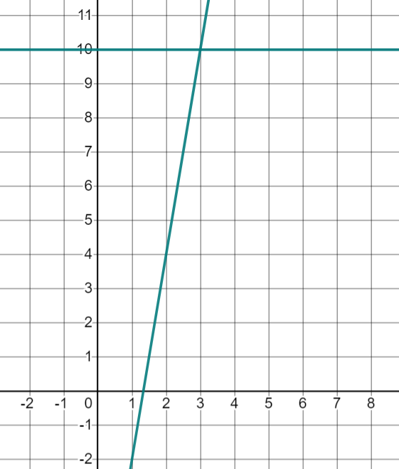
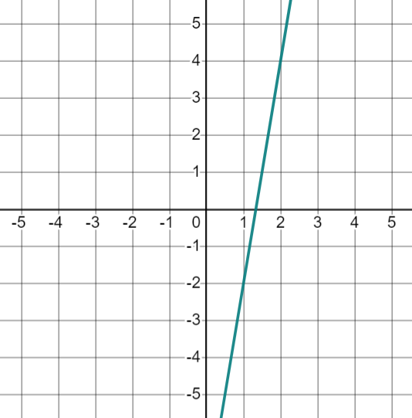
Finding solutions from graphs
We can use graphs to find solutions to equations with unknowns on one side.
Find the solution to the equation 6x − 8 = 10
First we can graph the value of the expression 6x − 8
If you are using graphing software you can type y = 6x − 8 and this will plot the value of the expression 6x − 8 on the y-axis.
We want to know when this expression is equal to 10
We can draw the graph of the equation y = 10 to help.
You may need to adjust the axes or zoom out to see both graphs.

Slide 25
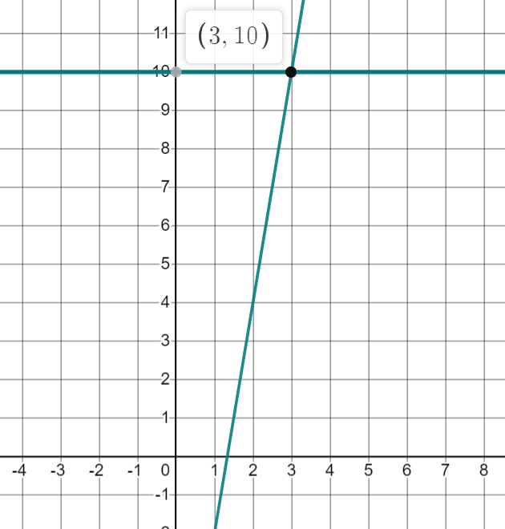
Finding solutions from graphs
Where can we see that 6x − 8 is equal to 10 ?
Where the graphs of the equations y = 6x − 8 and y = 10 intersect.
The graphs intersect at (3, 10)
So the solution to the equation 6x − 8 = 10 is when x = 3
To check:
6(3) − 8 = 10
18 − 8 = 10
Both sides of the equation are equal so this is a solution.

Slide 26
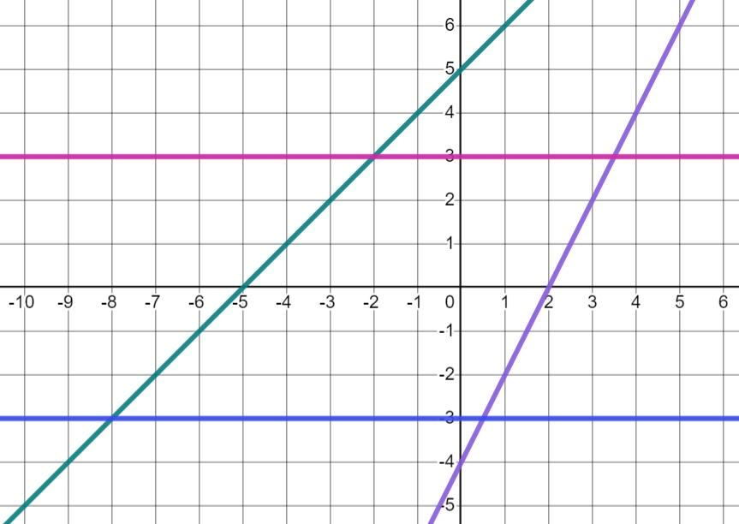
Finding solutions from graphs
Line A (pink) has equation y = 3
Line B (green) has equation y = x + 5
Line C (purple) has equation y = 2x − 4
Line D (blue) has equation y = −3
B
C
A
What equations will we be able to find solutions for using these lines?
D
x + 5 = 3
x + 5 = −3
2x − 4 = 3
2x − 4 = −3
Which of these equations will have negative solutions? How do you know?
2x − 4 = x + 5
(intersect off the picture)
The lines intersect on a coordinate with a negative x value.

Slide 27
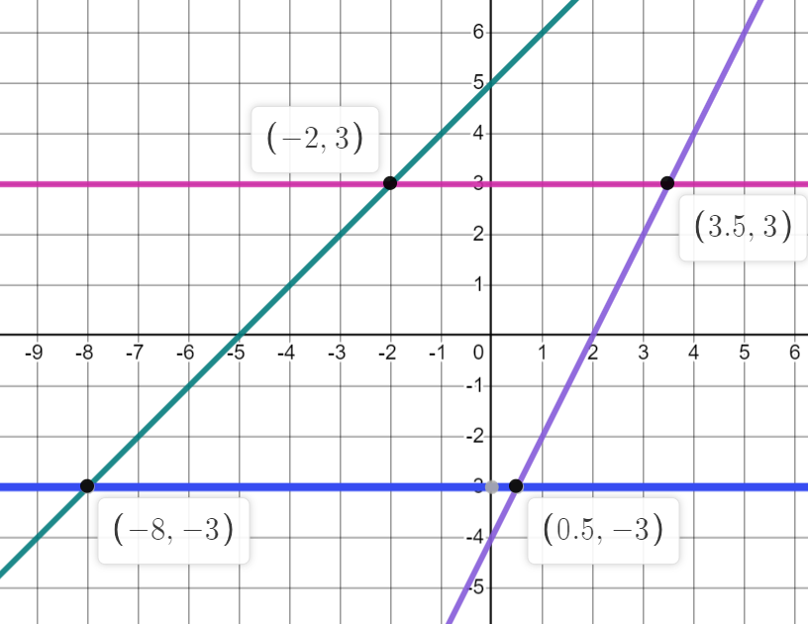
Finding solutions from graphs
Line A (pink) is y = 3
Line B (green) is y = x + 5
Line C (purple) is y = 2x − 4
Line D (blue) is y = −3
B
C
A
What are the solutions to each of these equations?
D
x + 5 = 3
x + 5 = −3
2x − 4 = 3
2x − 4 = −3
x = −2
x = 3.5
x = −8
x = 0.5

Slide 28
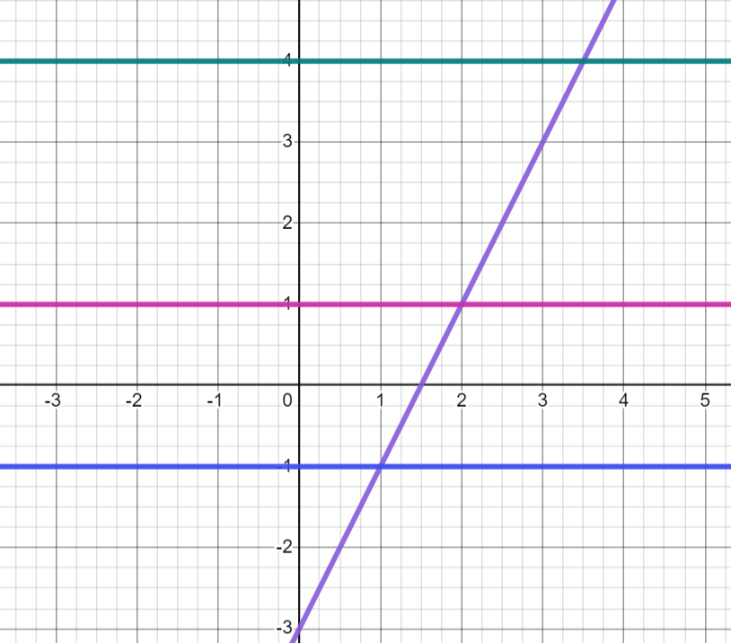
Finding solutions from graphs
The line of the equation y = 2x − 3 has been drawn on the graph below (purple diagonal line).
Use the horizontal lines drawn to find the solution to these equations:
2x − 3 = 1
2x − 3 = 4
2x − 3 = −1
Solution when x = 2
Solution when x = 3.5
Solution when x = 1

Slide 29
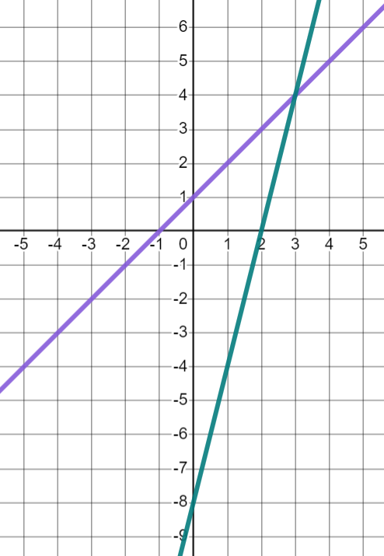
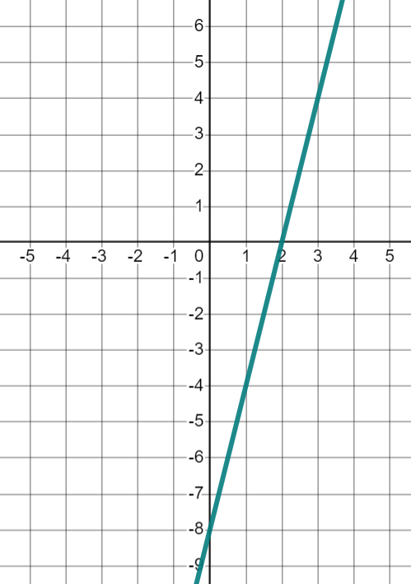
Finding solutions from graphs
We can use a similar method to find solutions to equations with unknowns on both sides of the equals sign.
Find the solution to the equation 4x − 8 = x + 1
We can start by graphing the expression 4x − 8
If we want to know when this is equal to x + 1 we can also graph the expression x + 1
If we want to know when this equation is balanced, we are looking for a value for x which gives 4x − 8 and x + 1 the same value.

Slide 30



Finding solutions from graphs
The solution to the equation 4x − 8 = x + 1 is where the graphs of 4x − 8 and x + 1 intersect.
The solution is (3, 4)
I think the solution is 3
I think the solution is 4
Aisha
Jacob
Lucas
What do you think?
The solution is the value of x which makes both expressions have the same value. This is when x = 3
What does the number 4 represent?
4 is the value of the expressions on both sides of the equation when x = 3

Slide 31
Finding solutions from graphs
We know that some equations do not have any solutions.
These equations will not have any solutions. Why do you think that is?
x = x − 6
5x + 4 = 5x
2x + 5 = 2x + 3
2 − x = 7 − x
They have the same coefficient of x on both sides of the equation it is impossible to add different values onto the same number and get the same answer.
What will happen if I plot both expressions from the first equation?

Slide 32
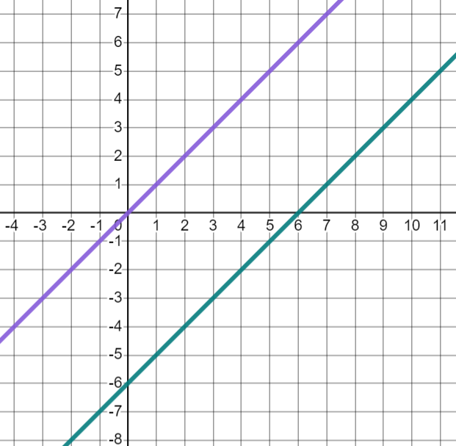
Finding solutions from graphs
What will happen if I plot both expressions from the first equation?
x = x − 6
The lines will be parallel.
This equations will not have any solutions as the graphs of the expressions are parallel and will never cross.
When the equation of a straight line is written in the form y = mx + c the coefficient of x (m) is the gradient.
When two lines have the same gradient they will be parallel.

Slide 33
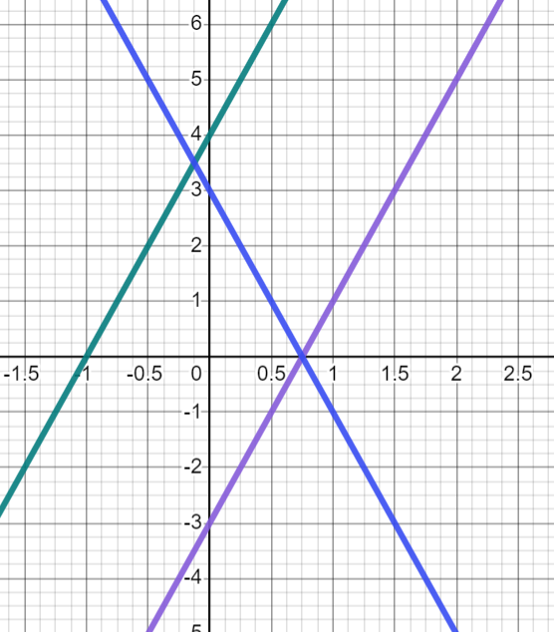

Finding solutions from graphs
Below are the graphs of equations:
(A) y = 3 − 4x, (B) y = 2(2x + 2) and (C) y = 4x − 3
Which of these equations will have solutions?
B
A
C
a
3 − 4x = 4x − 3
(When x = 0.75)
b
3 − 4x = 2(2x + 2)
(When x = −0.125)
c
4x − 3 = 2(2x + 2)
Lines are parallel so no solution.
4x − 3 = 4x + 4

Slide 34
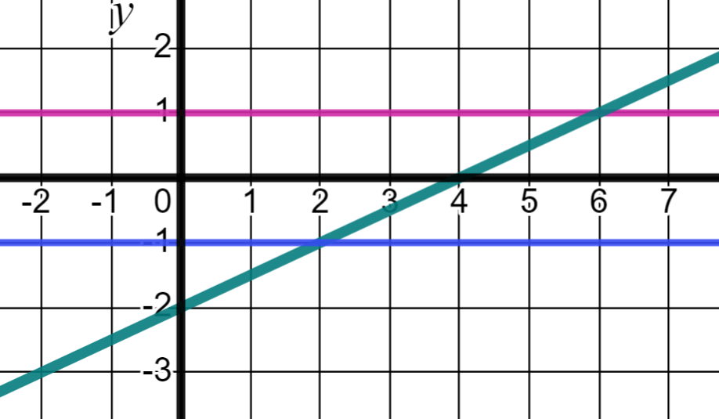
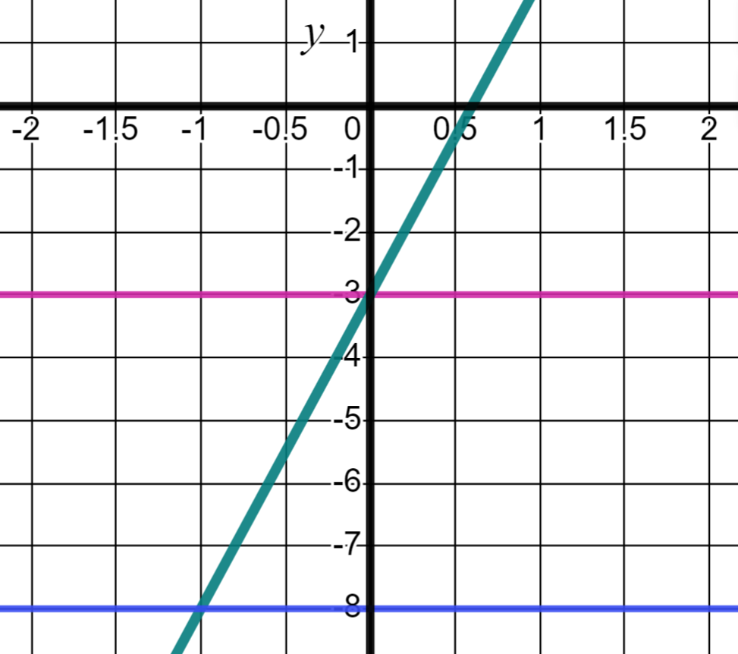
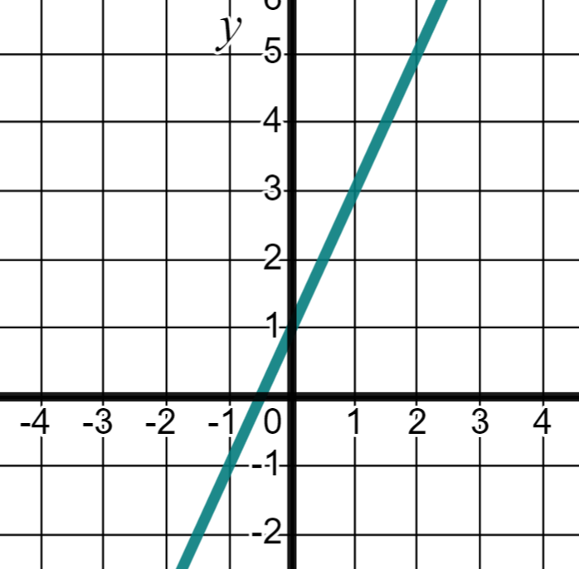


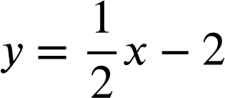

Finding solutions from graphs
1a) Use the lines on the graph to solve the equations below.
1b) Below is the graph of the equation y = 5x − 3 Use it to solve the equations.
1c) Solve the equations below by drawing the relevant graphs.
equation | solution
x − 2 = 1
x − 2 = −1
equation | solution
5x − 3 = −3
5x − 3 = −8
equation | solution
2x + 1 = 3
2x + 1 = 1

Slide 35
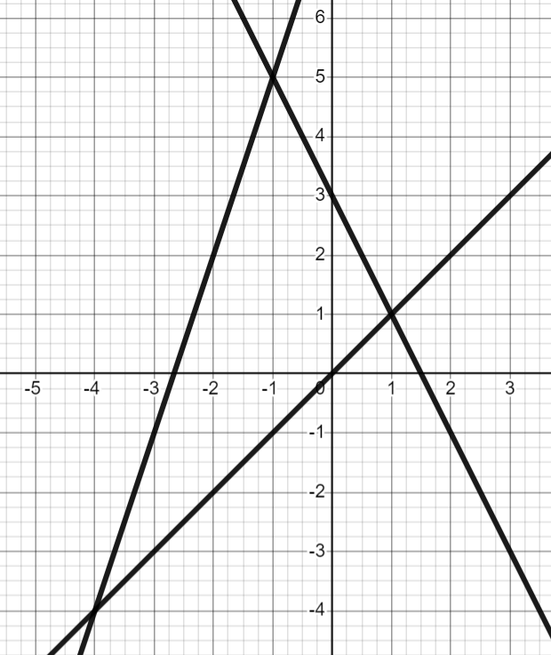
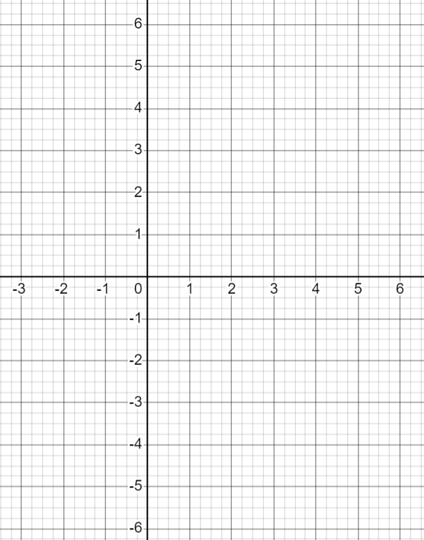



Finding solutions from graphs
2) Use the lines on the graph to solve the equations.
3) Solve the equation below by drawing the relevant graphs.
a) | equation | solution
 | x = 3 − 2x
y = 3x − 3
x | −1 | 0 | 1 | 2 | 3
y
y = 5 − x
b) | equation | solution
 | x = 3x + 8
x | −1 | 0 | 1 | 2 | 3
y
c) | equation | solution
 | 3x + 8 = 3 − 2x
equation | solution
3x − 3 = 5 − x

Slide 36
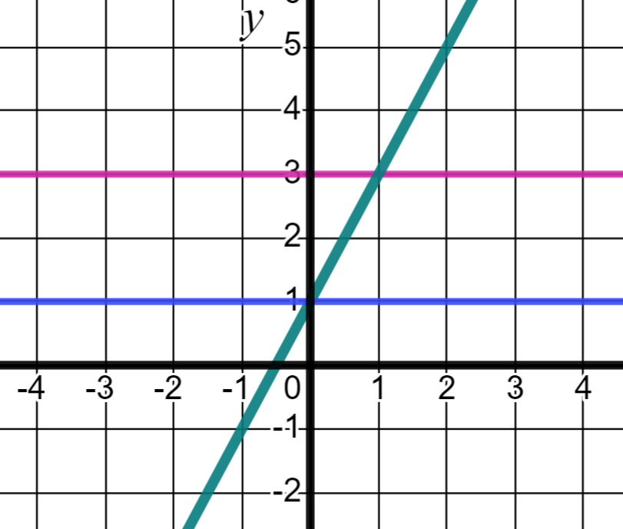
Finding solutions from graphs
1a) Use the lines on the graph to solve the equations below.
1b) Below is the graph of the equation y = 5x − 3 Use it to solve the equations.
1c) Solve the equations below by drawing the relevant graph.
equation | solution
x − 2 = 1 | x = 6
x − 2 = −1 | x = 2
equation | solution
5x − 3 = −3 | x = 0
5x − 3 = −8 | x = −1
equation | solution
2x + 1 = 3 | x = 1
2x + 1 = 1 | x = 0

Slide 37
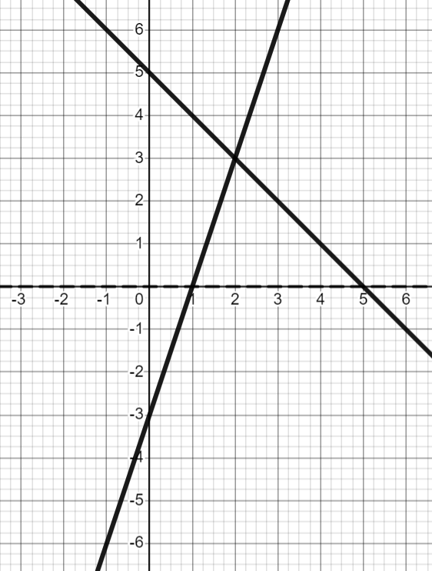
Finding solutions from graphs
2) Use the lines on the graph to solve the equations.
3) Solve the equation below by drawing the relevant graphs.
a) | equation | solution
 | x = 3 − 2x | x = 1
y = 3x − 3
x | −1 | 0 | 1 | 2 | 3
y | −6 | −3 | 0 | 3 | 6
y = 5 − x
b) | equation | solution
 | x = 3x + 8 | x = −4
x | −1 | 0 | 1 | 2 | 3
y | 6 | 5 | 4 | 3 | 2
c) | equation | solution
 | 3x + 8 = 3 − 2x | x = −1
equation | solution
3x − 3 = 5 − x | x = 2

Slide 38
Solution to an equation
In a linear equation there is a particular value that makes the equation balance, this is called the solution.
Finding the solution to an equation is called solving.
We can test whether a value is a solution by substituting into the equation and checking both sides balance
We can find the solution to an equation on a graph by graphing the expressions on both sides of the equals sign and seeing where they intersect.

Slide 39

© Oak National Academy 2023.
Produced in partnership with Mathematics in Education and Industry.
Licensed on the Open Government Licence v3.0, except where otherwise stated. See Oak terms and conditions.

